Slide 1
Introduction to Internet of Things
Instructor: Deepak Gangadharan

Slide 2
General Information
Office: Vindhya A5-303
Email: deepak.g@iiit.ac.in
Course Grading
Component | Marks
Quiz 1 | 10
Quiz 2 | 10
Lab exercise | 10
Lab exam | 20
End Sem | 50

Slide 3
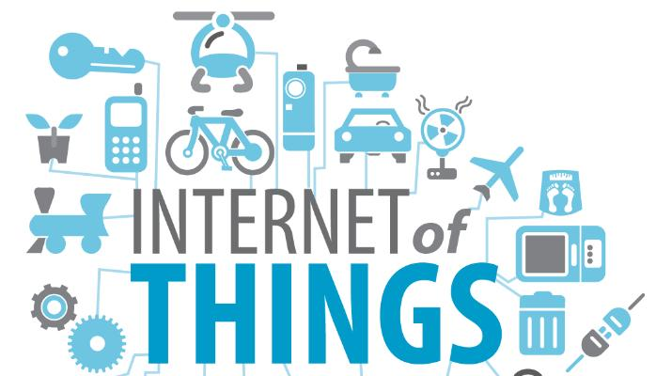
Outline
History of IoT
What is IoT?
IoT Applications
M2M vs IoT
Importance of IoT
Challenges/Impediments
Case Study
Source: https://www.groundreport.com/

Slide 4
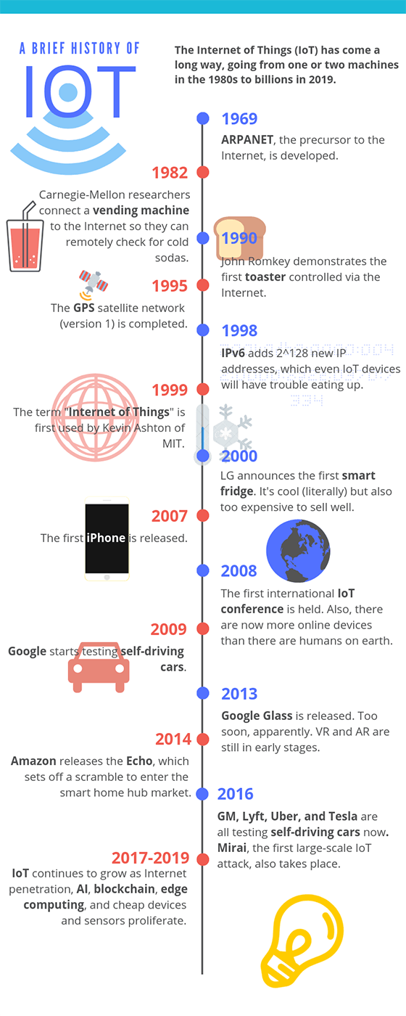
History of IoT
1969 – ARPANET was put into service by DARPA, which paved way for the “Internet” ◊
1982 – A Coca-Cola vending machine is connected to the Internet by researchers at CMU to check availability of cold sodas. Often cited as one of the first IoT devices.
1990 – John Romkey, an Internet pioneer connected a smart toaster to the Internet and controlled it. ◊
1995 – The first GPS satellite program of US government is completed making it possible to get location information required for many IoT devices
1998 – 128-bit IPv6 becomes a draft standard allowing more devices to be addressed than IPv4 could (32-bit). ◊
1999 – A big year for IoT as the term was used for the first time by Kevin Ashton, a cofounder of Auto-ID center at MIT
Source: https://www.iottechtrends.com/history-of-iot/

Slide 5
History of IoT (continued)
2000 – LG introduced the Internet refrigerator with screens and trackers to keep track of the food that was there in the fridge. It was expensive. ◊
2007 – The first iPhone is released allowing people to interact with the world and internet connected devices in a whole new way.
2008 – The first international IoT conference was held in Zurich and also the number of Internet connected devices surpassed the number of humans.
2009 – Google starts self-driving car tests
2014 – Amazon Echo is released which paves way for the Smart Home Hub market
2016 – GM, Lyft, Tesla and Uber all start testing self-driving cars
Source: https://www.iottechtrends.com/history-of-iot/

Slide 6
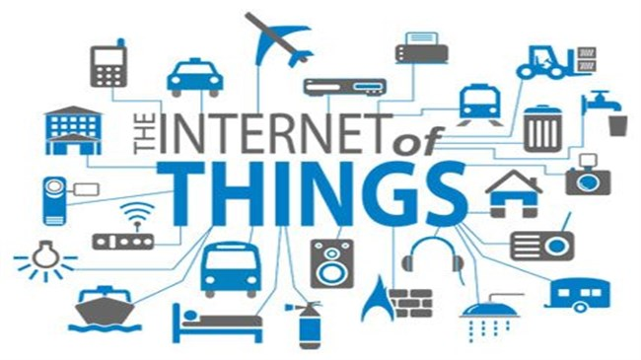
What is IoT?
Source: https://www.gartner.com/en/information-technology/glossary/internet-of-things
Definition The Internet of Things (IoT) is the network of physical objects that contain embedded technology to communicate and sense or interact with their internal states or the external environment. – By Gartner Research
Source: https://www.groundreport.com/

Slide 7
What is IoT?
Alternate definitions
- A global infrastructure for the information society, enabling advanced services by interconnecting (physical and virtual) things based on existing and evolving interoperable information and communication technologies.
- The Internet of Things (IoT) is a system of interrelated computing devices, mechanical and digital machines, objects, animals or people that are provided with unique identifiers (UIDs) and the ability to transfer data over a network without requiring human-to-human or human-to-computer interaction.
Source: https://www.itu.int/rec/T-REC-Y.2060-201206-I
Source: https://internetofthingsagenda.techtarget.com/definition/Internet-of-Things-IoT

Slide 8
What is IoT?
Simple Definition Internet of Things (IoT) is a simple concept which means taking all the things in the world and connecting them to the internet.
But is connecting everything to Internet enough for IoT?
The true potential of IoT is realized when the connected things can sense the environment and send data or receive data and trigger some action or do both.

Slide 9
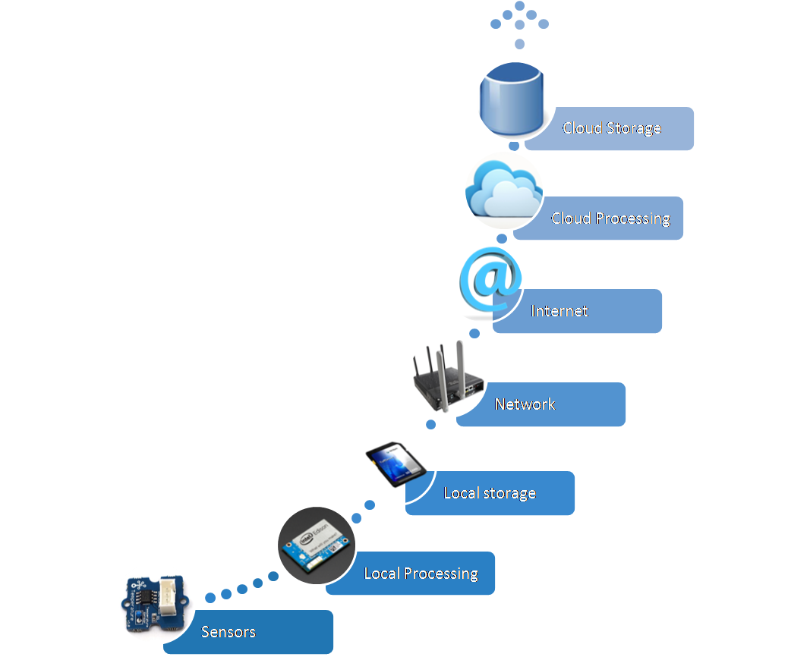
Upstream Information Flow in IoT
The initial information flow did not encompass the local storage and the local processing – Purely cloud based processing
Currently edge computing is a concept that is gaining prominence whereby there is availability of some local processing and storage
Source: http://ocw.cs.pub.ro/courses/_media/iot2015/courses/picture11.png?w=450&tok=584430

Slide 10
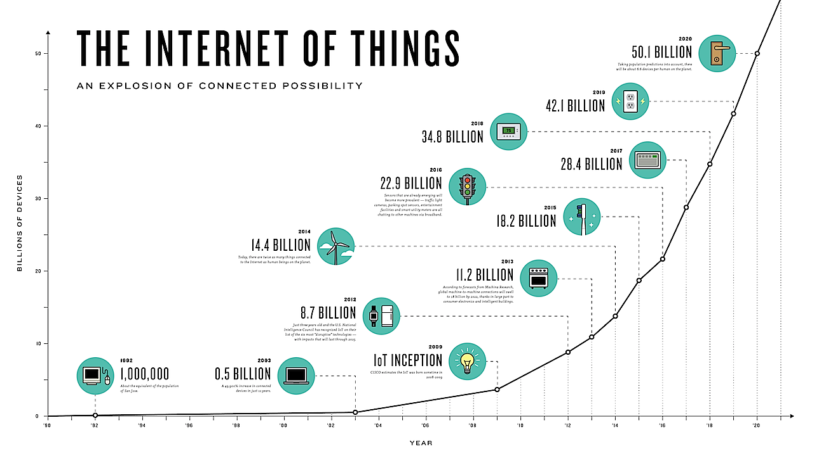
Evolution of IoT
Source: https://www.weforum.org/agenda/2017/06/internet-of-things-will-power-the-fourth-industrial-revolution/

Slide 11
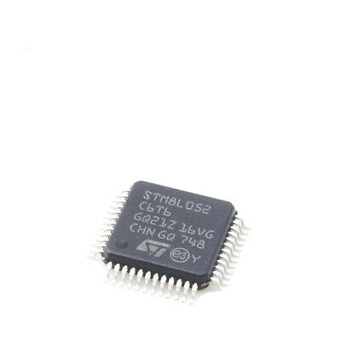
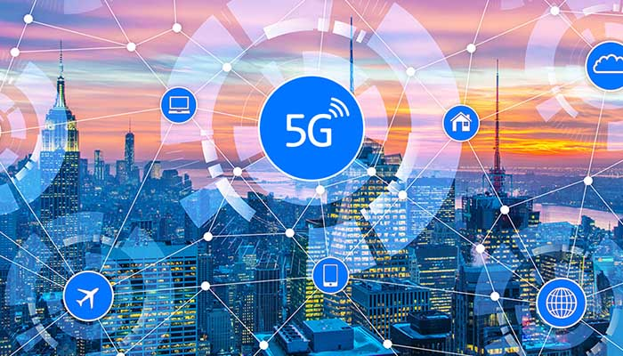
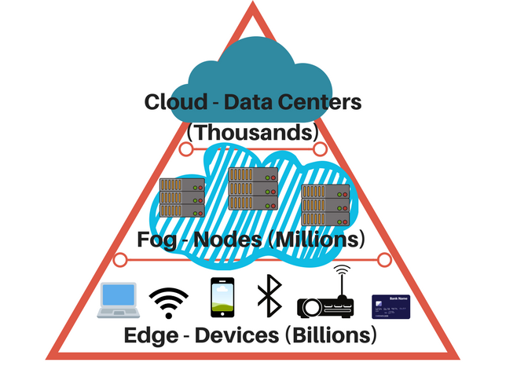
Why is IoT buzz word now?
Embedded chips are becoming cheaper, smaller and low power devices
Emergence of faster communication technologies
Flexibility of IPv6 to address more IoT devices
Emergence of fog/edge computing
Advances in Big Data, Deep Learning and AI understanding
Source: https://timestech.in/gartner-say-worldwide-5g-network-infrastructure-revenue-will-reach-4-billion-in-2020/
Source: https://www.power-solutions.com/industry-trends-best-practices/industry-trends/fog-computing-and-edge-computing-what-you-need-to-know

Slide 12
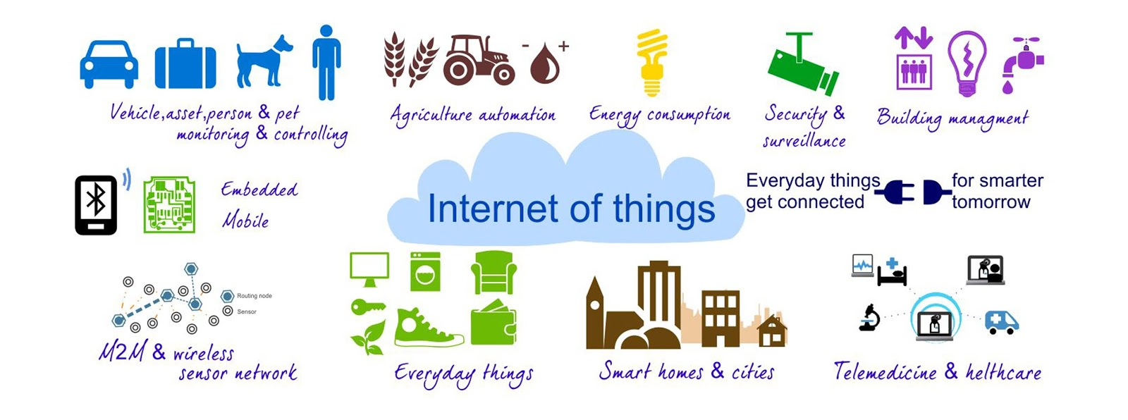
IoT Applications
Source: https://iotworm.com/internet-of-things-applications-area/

Slide 13
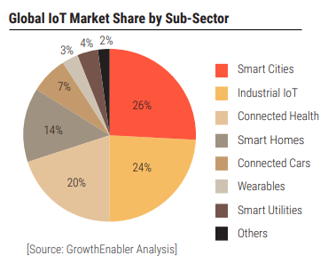
IoT market share

Slide 14
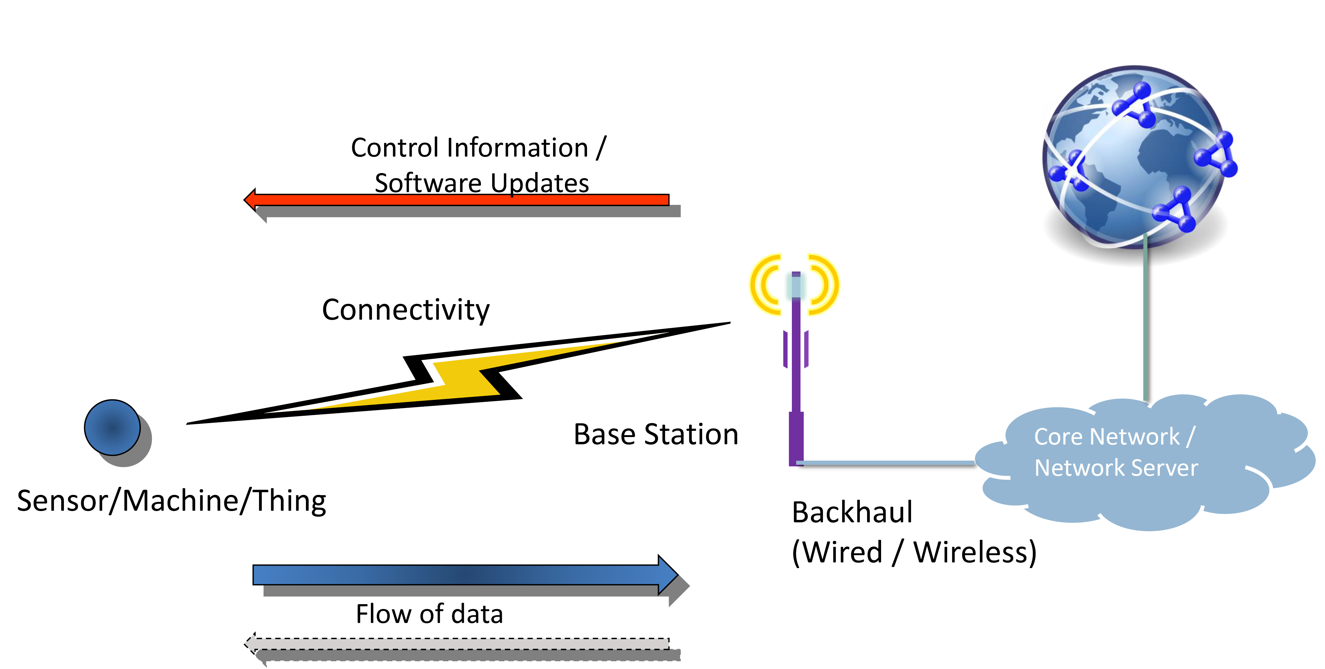
High Level Architecture of Machine-to-Machine (M2M)/IoT
Source: https://www.slideshare.net/3G4GLtd/m2m-mtc-iot

Slide 15
Machine-to-Machine (M2M)
Source: https://www.slideshare.net/3G4GLtd/m2m-mtc-iot

Slide 16
Internet of Things (IoT)
Source: https://www.slideshare.net/3G4GLtd/m2m-mtc-iot

Slide 17
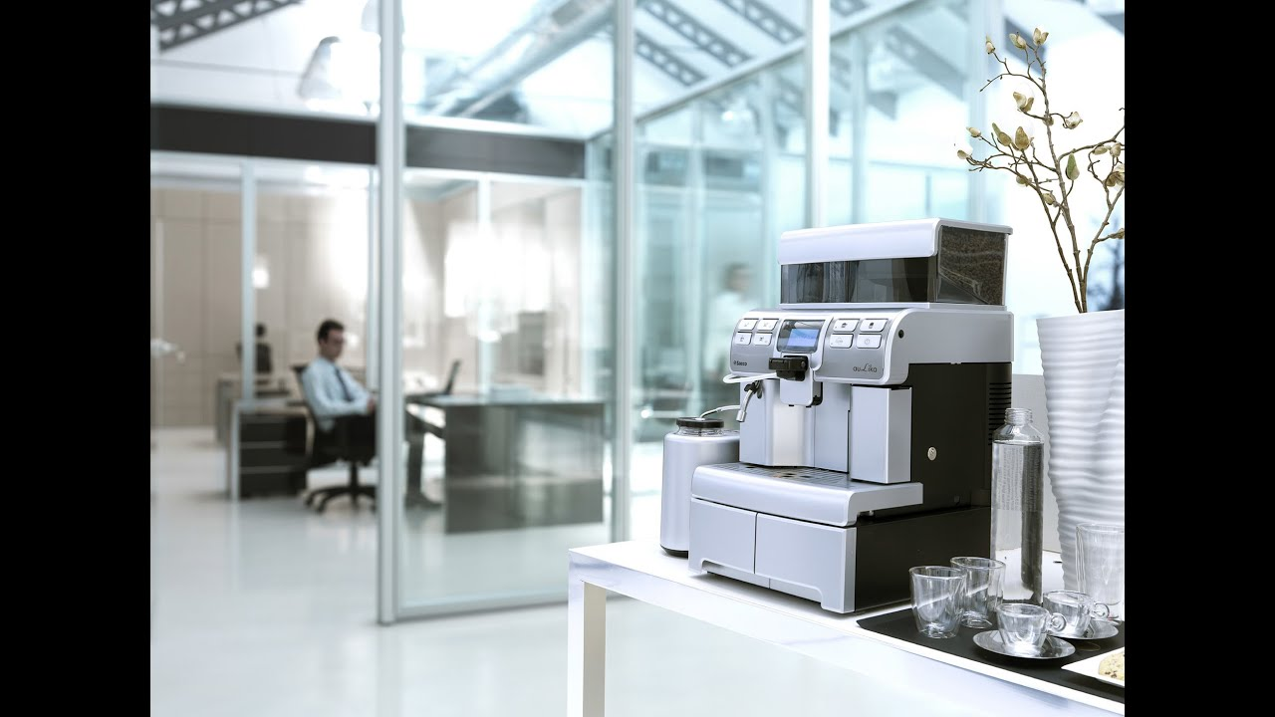
M2M vs IoT
Content adapted from https://www.slideshare.net/3G4GLtd/m2m-mtc-iot
Assumption: There are 6 such machines one on each floor of a 6 storey office complex
Scenario 1: No connectivity The machine has to be checked manually to determine sufficient availability of materials like coffee beans, chocolate powder, milk powder
Source: https://www.youtube.com/watch?v=dX-8H6vLm1E

Slide 18
M2M vs IoT
Content adapted from https://www.slideshare.net/3G4GLtd/m2m-mtc-iot
Scenario 2: Basic Connectivity (M2M) The machine has some sensor that can detect a fall in one of the materials below a certain required threshold and can send a notification message on phone or by email
Source: https://www.youtube.com/watch?v=dX-8H6vLm1E

Slide 19

M2M vs IoT
Content adapted from https://www.slideshare.net/3G4GLtd/m2m-mtc-iot
Scenario 3: Advanced connectivity (IoT) If the machine is connected to the office system and has access to the database with information of who comes when and what is their consumption pattern of coffee/other drink, then it can make optimized decisions of when and what materials need to be topped up
Source: https://www.youtube.com/watch?v=dX-8H6vLm1E

Slide 20
M2M Evolution to IoT

Slide 21
Importance of IoT
Gathers useful data: Significant information gathered helps in making the right decision. If something malfunctions in the system, it can be maintained because the information is gathered.
Focuses on Automation and Control: Connectivity of physical objects and their control using wireless support enables significant control and automation without the need of human intervention, which makes execution faster leading to timely output.
Useful in Monitoring: Helps knowing things in advance, i.e., collects information on quantity of supplies, water distribution and consumption, intelligent energy management, which also allows taking necessary actions.
Increases efficiency and saves time
Improves quality of life

Slide 22
Challenges/Impediments
Privacy and Security: Connectivity brings vulnerability to leakage of user identity and confidential data
Huge Volume of Data: With increasing number of connected devices, the amount of data generated will be huge, which will need advancements in storage technology and processing infrastructure
Complexity: The increasing complexity of IoT systems with increasing number of connected devices makes it difficult to verify such a system for safety and correctness
Intermittent Connectivity: A mobile node may experience lack of connectivity on its path which reduces the quality of user experience

Slide 23

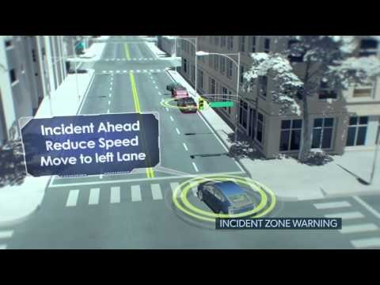
IoT Case Study
IoT in restaurant business
IoT in connected vehicles

Slide 24
Thank you

